Slide 1
Azure Serverless Updates
What’s New from BUILD 2019
Michael S. Collier
13 May 2019
Principal SDE, Microsoft

Slide 2
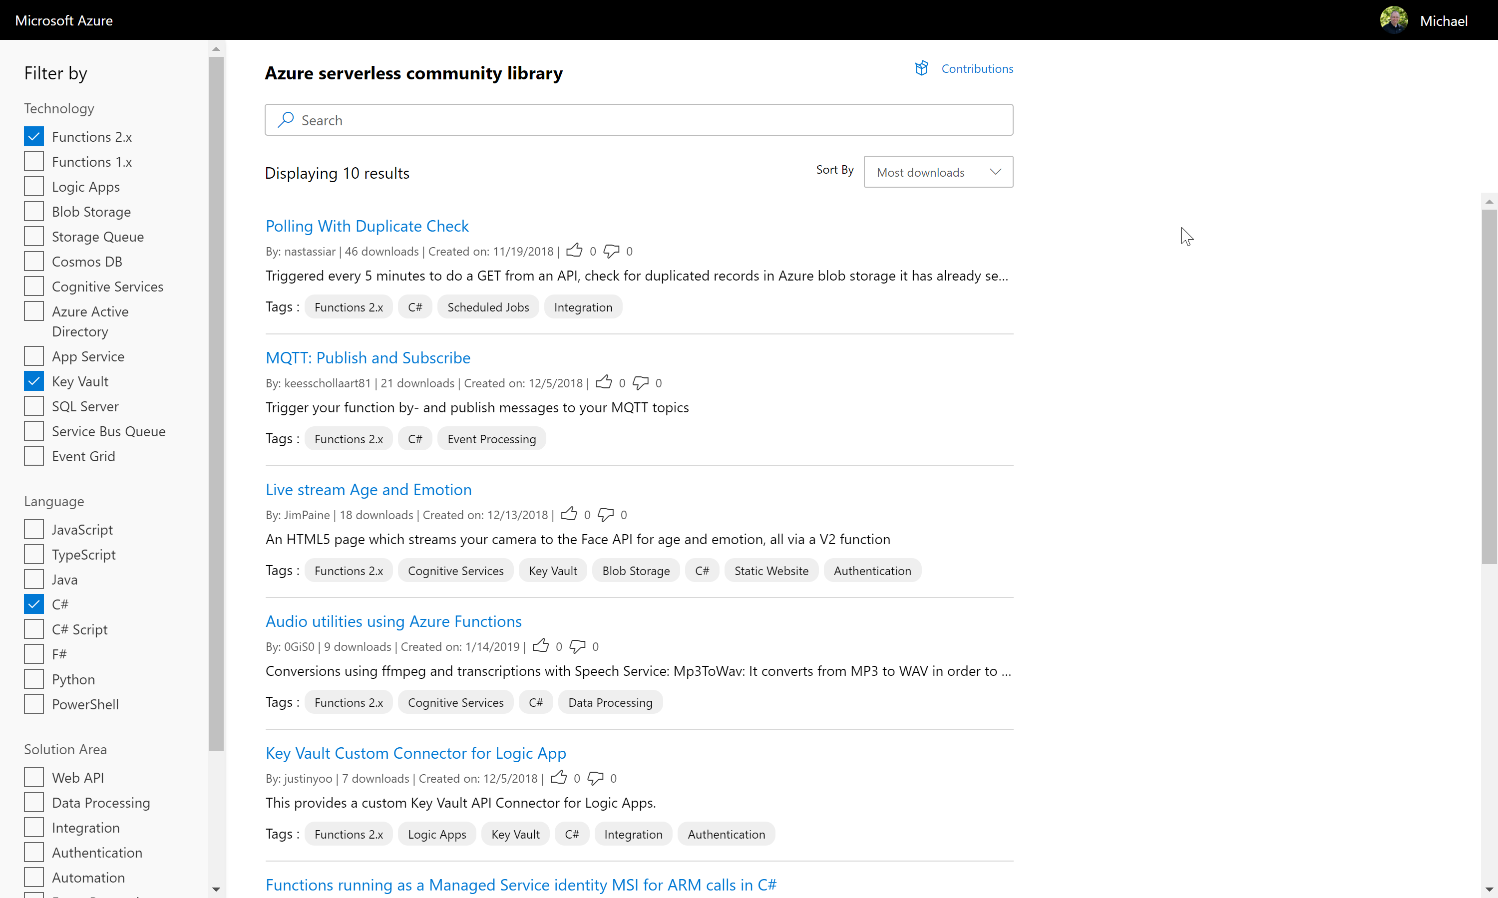
ServerlessLibrary.net
Notes:
Login to contribute with GitHub, directly on the site!
More details about each sample
New tagging system
Search and filter relevant samples

Slide 3
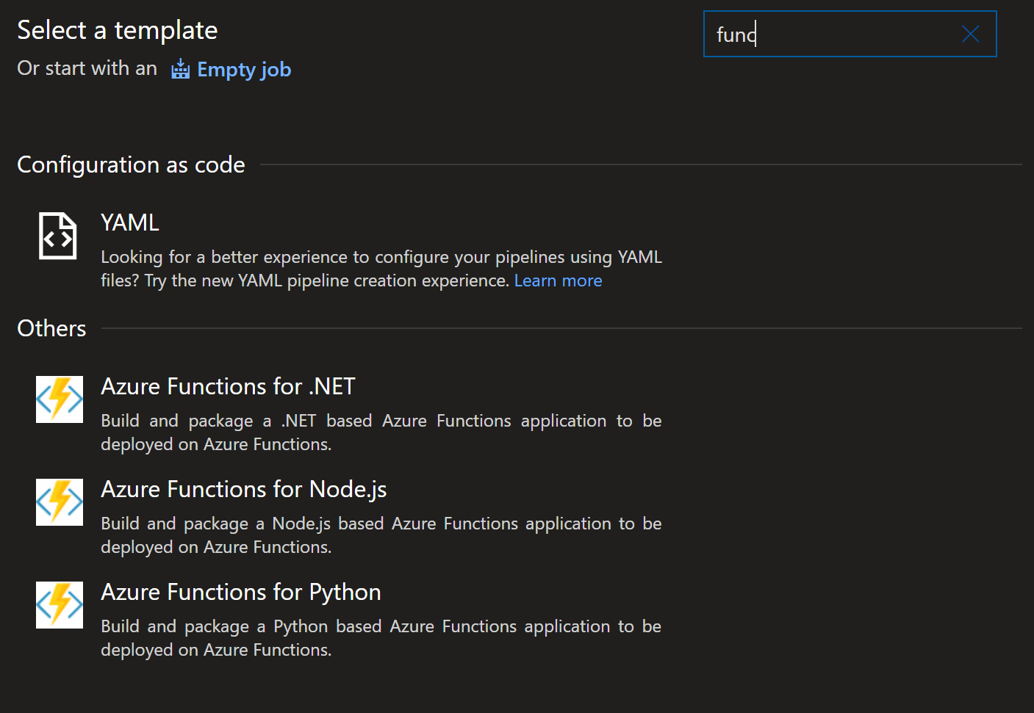
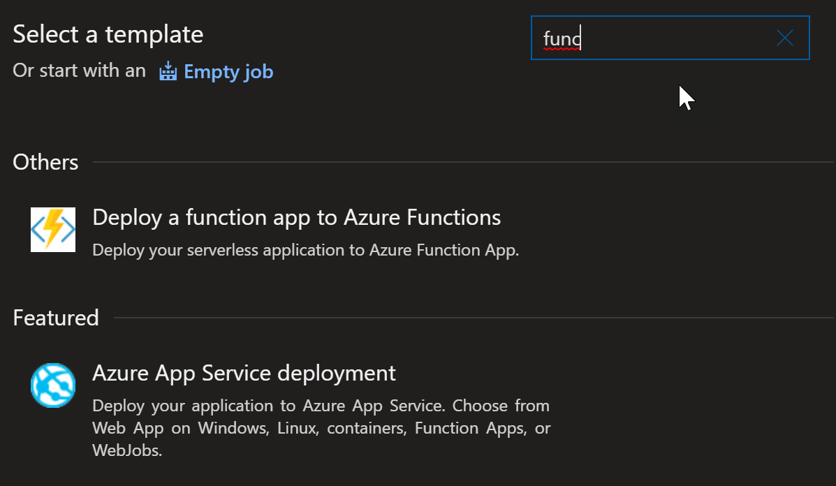
Azure Pipelines
Streamlined Build and Release experience
Create pipeline via Azure CLI
Notes:
https://aka.ms/functions-azure-devops

Slide 4
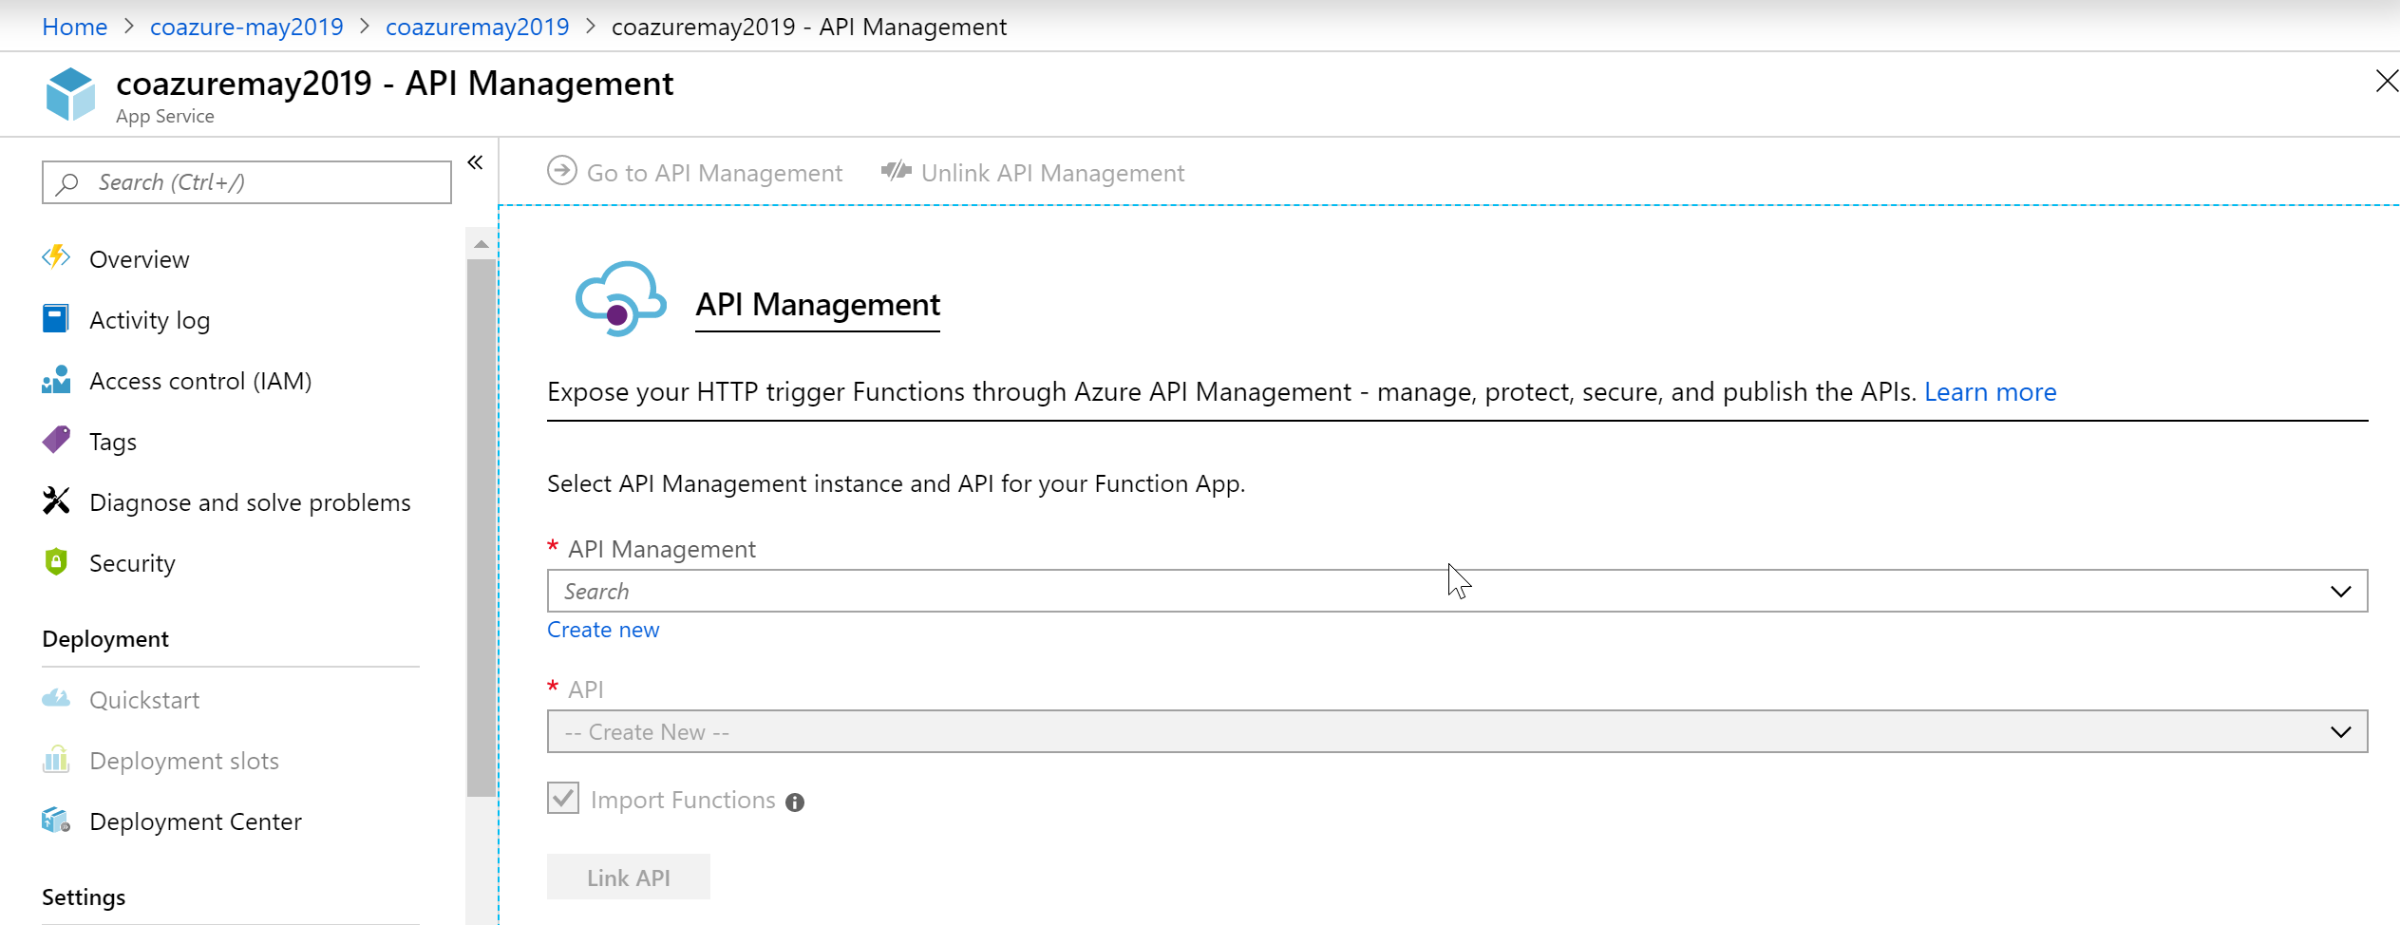
Functions + API Management
Simplified experience to exposed Functions via API Management
Notes:
https://aka.ms/functionstoapim

Slide 5
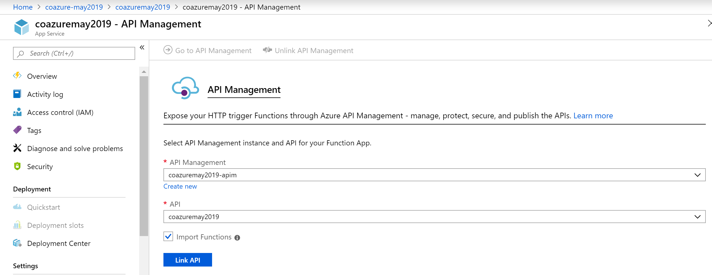
Functions + API Management
Simplified experience to exposed Functions via API Management
Notes:
https://aka.ms/functionstoapim

Slide 6
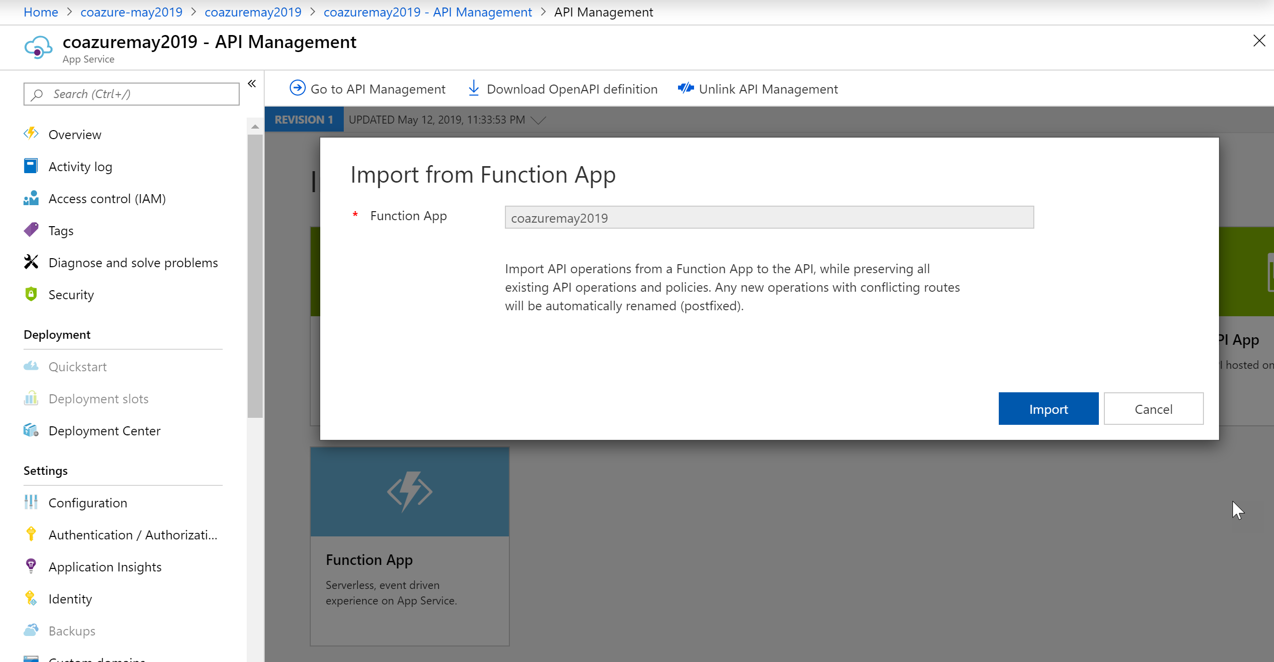
Functions + API Management
Simplified experience to exposed Functions via API Management
Notes:
https://aka.ms/functionstoapim

Slide 7
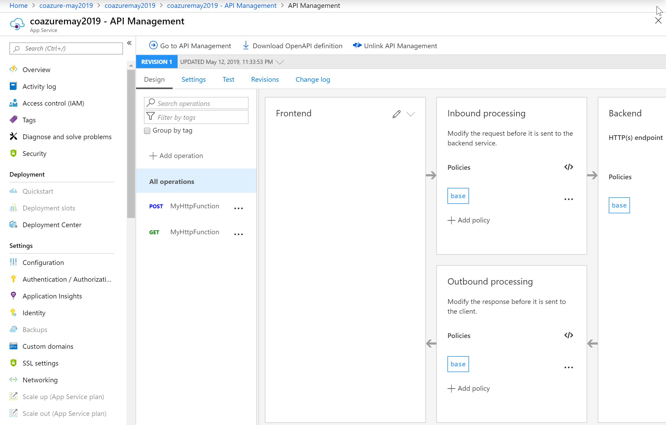
Functions + API Management
Simplified experience to exposed Functions via API Management
Notes:
https://aka.ms/functionstoapim

Slide 8
Durable Functions - Events

Slide 9
Durable Functions – Dependency Injection
Notes:
https://github.com/Azure/azure-functions-dotnet-extensions/tree/master/src/samples/DependencyInjection

Slide 10
Extension Bundle
Include all Microsoft Azure Functions’ team extensions.
{
"version": "2.0",
"exensionBundle": {
"id": "Microsoft.Azure.Functions.ExtensionBundle",
"version": "[1.*, 2.0.0)"
}
}
Package | Version
Microsoft.Azure.WebJobs.Extensions.CosmosDB | 3.0.3
Microsoft.Azure.WebJobs.Extensions.DurableTask | 1.8.0
Microsoft.Azure.WebJobs.Extensions.EventGrid | 2.0.0
Microsoft.Azure.WebJobs.Extensions.EventHubs | 3.0.3
Microsoft.Azure.WebJobs.Extensions.SendGrid | 3.0.0
Microsoft.Azure.WebJobs.Extensions.ServiceBus | 3.0.3
Microsoft.Azure.WebJobs.Extensions.SignalRService | 1.0.0
Microsoft.Azure.WebJobs.Extensions.Storage | 3.0.4
Microsoft.Azure.WebJobs.Extensions.Twilio | 3.0.0
Include in host.json file.
Notes:
https://aka.ms/functions-extensionbundle

Slide 11
KEDA

Slide 12
Azure App Service
Notes:
https://azure.microsoft.com/en-us/blog/azure-app-service-update-free-linux-tier-python-and-java-support-and-more/

Slide 13
Azure Functions
Durable Functions for JavaScript 1.2.0
Session-enabled Service Bus trigger
Notes:
https://github.com/Azure/azure-functions-durable-js/releases/tag/1.2.0
https://aka.ms/functions-sbextension

Slide 14
Presentation title
Session subtitle
Speaker Name
Date
Speaker title

Slide 15
Presentation title
Session topic
Sample layouts
Sample charts and visuals
Speaker Name
Speaker title

Slide 16
Preferred text layout (no bullets)
Subtitle (if needed)
Main topic: Size 28pt Semibold
Size 20pt for subtopic text
Size 20pt for subtopic text
Main topic: Size 28pt Semibold
Size 20pt for subtopic text
Size 20pt for subtopic text
Main topic: Size 28pt Semibold
Size 20pt for subtopic text
Size 20pt for subtopic text

Slide 17
Preferred text layout (bullets)
Subtitle (if needed)
Main topic: Size 28pt Semibold
Size 20pt for subtopic text
Size 20pt for subtopic text
Main topic: Size 28pt Semibold
Size 20pt for subtopic text
Size 20pt for subtopic text
Main topic: Size 28pt Semibold
Size 20pt for subtopic text
Size 20pt for subtopic text

Slide 18
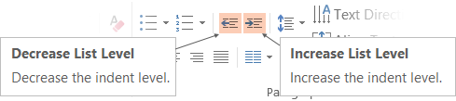
Adjusting list levels
Use the “Decrease List Level” and “Increase List Level” tools on the Home Menu to change text levels.
Try this:
Place your cursor in any row of text to the left that says “Size 20pt for subtopics.”
Next click the Home tab, and then on the “Decrease List level” tool. Notice how the line moves up one level.
Now try placing your cursor in one of the “Main topic…” lines of text. Click the “Increase List Level” tool and see how the text is pushed in one level.
Use these 2 tools to adjust your text levels as you work.
Main topic: Size 28pt Semibold
Size 20pt for subtopic text
Size 20pt for subtopic text
Main topic: Size 28pt Semibold
Size 20pt for subtopic text
Size 20pt for subtopic text
Main topic: Size 28pt Semibold
Size 20pt for subtopic text
Size 20pt for subtopic text

Slide 19
Slides with code snippets
We can make some really interesting points to discuss an API, while providing a code snippet on the side.
Benefits of doing this:
Makes the content more useful.
Breaks up the flow a bit.
Makes concepts real.
interest CodeSampleSlide (int slideNumber) {
if (slideNumber < 10) {
return interest.curious;
} else {
// we’re going way too long
return interest.sleepy;
}
}

Slide 20
Standalone code snippet slide
interest CodeSampleSlide (int slideNumber) {
if (slideNumber < 10) {
return interest.curious;
} else {
// we’re going way too long
return interest.sleepy;
}
}

Slide 21
This is a big statement slide. Font is 44pt Segoe UI Regular. To keep lines of text together, use soft returns (shift + return).
— Firsty Lastnamington

Slide 22
Table 3 columns
Table header | Table header | Table header
Text | Text | Text
Text | Text | Tip: To quickly add a row, place cursor in this last cell and hit Tab key

Slide 23

Image
Main topic: Size 28pt Semibold
Size 20pt for subtopic text
Size 20pt for subtopic text
Main topic: Size 28pt Semibold
The slant is on the master slide and can be used over any half-width photo or copy/pasted and reshaped to fit other photo layouts as needed.

Slide 24
Demo
Using this really cool feature
Speaker

Slide 25
Hidden text slide
Some speakers at Microsoft like to use this slide for hidden “notes slides”. These can be useful for providing details around demos (key points; code/script location; etc.).
Delete it if you don’t want to use it.

Slide 26
Sample charts and visuals

Slide 27
Standard Pie chart
Sample chart title can be added here

Slide 28
Standard Bar chart
Label 1
Label 2
Label 3
Label 4
Label 5

Slide 29
Timeline
Text Here
Text Here
Text Here
JAN 13’
FEB 13’
MAR 13”
APR 13’
MAY 13’
JUN 13’
JUL 13’
AUG 13’
SEP 13’
OCT 13’
NOV 13’
DEC 13’
Text Here
Text Here

Slide 30
Headline is 44pt Segoe UI Semibold
Main text is 24pt Segoe UI Regular. Keep right side of slide clear for graphs or illustrations.
2016
2011

Slide 31
Headline is 44pt Segoe UI Semibold
Another example of text with illustration.

Slide 32
Headline is 44pt Segoe UI Semibold
Graphs or illustrations can also extend across the bottom of the slide.
1B
200M
160M
10.4M

Slide 33
Headline is 44pt Segoe Semibold 2nd line if needed
Segoe UI 20pt
Hot Data
Tiered Storage
SSD
Cold Data
HDD

Slide 34
Headline Segoe UI Semibold 44pt
Chart title goes here
Insert chart text here
2nd line
Easy adoption:
Native compilation:
Segoe 12pt
10x
50x
Segoe 12pt
Chart caption goes here
Chart caption goes here

Slide 35
28pt Segoe UI Semibold
#1
50%
66%
libero interdum dignissim at porta libero
dis parturient montes, nascetur ridiculus mus
300k
75%
rutrum lacinia nunc nec interdum, per inceptos himenaeos
vestibulum nisi, hendrerit tempor tellus adipiscing vel
Aliquam sed venenatis erat, in ullamcorper nibh
71%
vulputate nunc, in viverra
arcu lacinia sollicitudin
pulvinar vestibulum justo
donec pharetra, justo in sodales
tristique, sapien libero sagittis justo ac posuere est magna in maurisn consequat eros
innteger orci ipsum, fringilla vitae dui quis, facilisis cursus tellusliquam sed venenatis erat, in ullamcorper
265B+
Cum sociis natoque penatibus et magnis dis parturient
100k+
aptent taciti sociosqu ad litora torquent per conubia nostra
viverra massa a odio auctor convallis

Slide 36
Video

Slide 37
Color map
 | FY17 | FY18 | Overall
US
Canada
LATAM
UK
Germany
France
WE
CEE
MEA
Japan
APAC
GCR
India

Slide 39
Presentation title
Session subtitle
Speaker Name
Date
Speaker title

Slide 40
Presentation title
Session topic
Sample layouts
Sample charts and visuals
Speaker Name
Speaker title

Slide 41
Preferred text layout (no bullets)
Subtitle (if needed)
Main topic: Size 28pt Semibold
Size 20pt for subtopic text
Size 20pt for subtopic text
Main topic: Size 28pt Semibold
Size 20pt for subtopic text
Size 20pt for subtopic text
Main topic: Size 28pt Semibold
Size 20pt for subtopic text
Size 20pt for subtopic text

Slide 42
Preferred text layout (bullets)
Subtitle (if needed)
Main topic: Size 28pt Semibold
Size 20pt for subtopic text
Size 20pt for subtopic text
Main topic: Size 28pt Semibold
Size 20pt for subtopic text
Size 20pt for subtopic text
Main topic: Size 28pt Semibold
Size 20pt for subtopic text
Size 20pt for subtopic text

Slide 43
Adjusting list levels
Use the “Decrease List Level” and “Increase List Level” tools on the Home Menu to change text levels.
Try this:
Place your cursor in any row of text to the left that says “Size 20pt for subtopics.”
Next click the Home tab, and then on the “Decrease List level” tool. Notice how the line moves up one level.
Now try placing your cursor in one of the “Main topic…” lines of text. Click the “Increase List Level” tool and see how the text is pushed in one level.
Use these 2 tools to adjust your text levels as you work.
Main topic: Size 28pt Semibold
Size 20pt for subtopic text
Size 20pt for subtopic text
Main topic: Size 28pt Semibold
Size 20pt for subtopic text
Size 20pt for subtopic text
Main topic: Size 28pt Semibold
Size 20pt for subtopic text
Size 20pt for subtopic text

Slide 44
Slides with code snippets
We can make some really interesting points to discuss an API, while providing a code snippet on the side.
Benefits of doing this:
Makes the content more useful.
Breaks up the flow a bit.
Makes concepts real.
interest CodeSampleSlide (int slideNumber) {
if (slideNumber < 10) {
return interest.curious;
} else {
// we’re going way too long
return interest.sleepy;
}
}

Slide 45
Standalone code snippet slide
interest CodeSampleSlide (int slideNumber) {
if (slideNumber < 10) {
return interest.curious;
} else {
// we’re going way too long
return interest.sleepy;
}
}

Slide 46
This is a big statement slide. Font is 44pt Segoe UI Regular. To keep lines of text together, use soft returns (shift + return).
— Firsty Lastnamington

Slide 47
Table 3 columns
Table header | Table header | Table header
Text | Text | Text
Text | Text | Tip: To quickly add a row, place cursor in this last cell and hit Tab key

Slide 48
Image
Main topic: Size 28pt Semibold
Size 20pt for subtopic text
Size 20pt for subtopic text
Main topic: Size 28pt Semibold
The slant is on the master slide and can be used over any half-width photo or copy/pasted and reshaped to fit other photo layouts as needed.

Slide 49
Demo
Using this really cool feature
Speaker

Slide 50
Hidden text slide
Some speakers at Microsoft like to use this slide for hidden “notes slides”. These can be useful for providing details around demos (key points; code/script location; etc.).
Delete it if you don’t want to use it.

Slide 51
Sample charts and visuals

Slide 52
Standard Bar chart
Label 1
Label 2
Label 3
Label 4
Label 5

Slide 53
Standard Pie chart
Sample chart title can be added here

Slide 54
Timeline
Text Here
Text Here
Text Here
JAN 13’
FEB 13’
MAR 13”
APR 13’
MAY 13’
JUN 13’
JUL 13’
AUG 13’
SEP 13’
OCT 13’
NOV 13’
DEC 13’
Text Here
Text Here

Slide 55
Headline is 44pt Segoe UI Semibold
2016
Main text is 24pt Segoe UI Regular. Keep right side of slide clear for graphs or illustrations.
2011

Slide 56
Headline is 44pt Segoe UI Semibold
Another example of text with illustration.

Slide 57
Headline is 44pt Segoe UI Semibold
Graphs or illustrations can also extend across the bottom of the slide.
1B
200M
160M
10.4M

Slide 58
Headline is 44pt Segoe Semibold 2nd line if needed
Segoe UI 20pt
Hot Data
Tiered Storage
SSD
Cold Data
HDD

Slide 59
Headline Segoe UI Semibold 44pt
Chart title goes here
Insert chart text here
2nd line
Easy adoption:
Native compilation:
Segoe 12pt
10x
50x
Segoe 12pt
Chart caption goes here
Chart caption goes here

Slide 60
28pt Segoe UI Semibold
#1
50%
66%
libero interdum dignissim at porta libero
dis parturient montes, nascetur ridiculus mus
300k
75%
rutrum lacinia nunc nec interdum, per inceptos himenaeos
vestibulum nisi, hendrerit tempor tellus adipiscing vel
Aliquam sed venenatis erat, in ullamcorper nibh
71%
vulputate nunc, in viverra
arcu lacinia sollicitudin
pulvinar vestibulum justo
donec pharetra, justo in sodales
tristique, sapien libero sagittis justo ac posuere est magna in maurisn consequat eros
innteger orci ipsum, fringilla vitae dui quis, facilisis cursus tellusliquam sed venenatis erat, in ullamcorper
265B+
Cum sociis natoque penatibus et magnis dis parturient
100k+
aptent taciti sociosqu ad litora torquent per conubia nostra
viverra massa a odio auctor convallis

Slide 61
Video

Slide 62
Color map
 | FY17 | FY18 | Overall
US
Canada
LATAM
UK
Germany
France
WE
CEE
MEA
Japan
APAC
GCR
India

Slide 64
Deck Resources
Azure PowerPoint Template
Fonts
Brand Colors
Common Icons (SVG format)

Slide 65
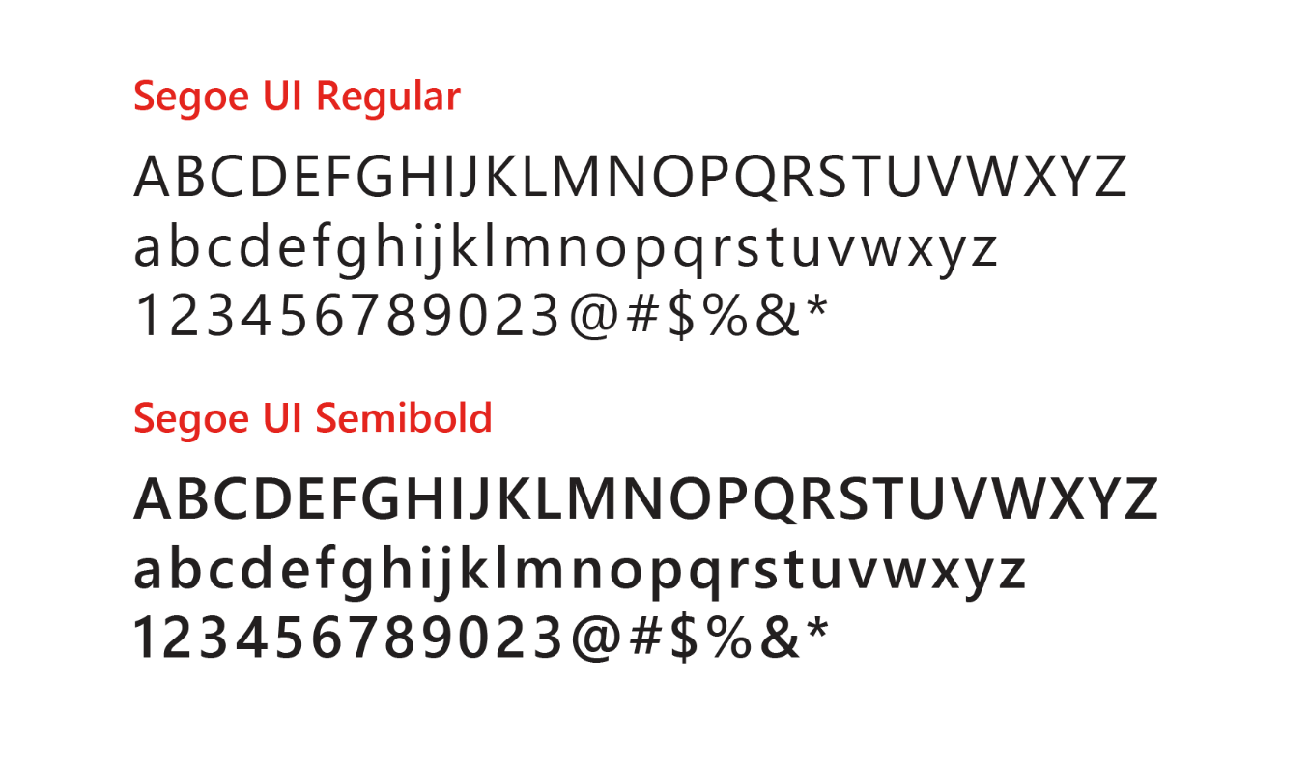
Segoe UI is the font that’s used for on-screen and digital executions
Follow these guidelines for PowerPoint
Size and weight
Limit type to no more than three sizes on a slide.
Use Semibold for text larger than 28pt.
Use Regular for increased legibility at small sizes or over backgrounds.
Use Semibold for subheads and headlines.
Segoe Black, Light and Condensed should not be used.
Case
Sentence case is our standard for all communications.
Use all-uppercase sparingly – for titles, short headings, or subheadings, and never for full paragraphs.
Don’t use all-lowercase type.
Justification
Type should be set flush left, ragged right. Avoid windows, orphans and lines that end with hyphens.

Slide 66
Our brand colors
Digital and on-screen applications use RGB or HEX color formulas. The color formulas are shown below.
Azure blue — a classic member of the Microsoft family of colors.
Azure Blue
R0 G120 B215 0078D7
Medium Blue
R77 G176 B255 4DB0FF
Light Blue
R177 G214 B242 B1D6F2
Chart Colors
R3 G90 B160
035AA0
R0 G120 B215
0078D7
R77 G176 B255 4DB0FF
R148 G208 B255 94D0FF
R177 G214 B242 B1D6F2

Slide 67
Colors and Accessibility
Type and background combinations must meet a minimum 4.5:1 contrast ratio or greater for accessibility. Examples below demonstrate correct color use for on-screen applications. Colors shown with notched corners require black/dark text to be accessible.
Light Yellow
R255 G241 B0
FFF100
Light Orange
R255 G140 B0
FF8C00
Light Magenta
R227 G0 B140
E3008C
Light Purple
R180 G160 B255
B4A0FF
Light Blue
R0 G188 B242
00BCF2
Light Teal
R0 G178 B148
00B294
Light Green
R186 G216 B10
BAD80A
Light accent colors
Yellow
R255 G185 B0
FFB900
Orange
R216 G59 B1
D83B01
Red
R232 G17 B35
E81123
Magenta
R180 G0 B158
B4009E
Purple
R92 G45 B145
5C2D91
Blue
R0 G120 B215
0078D7
Teal
R0 G130 B114
008272
Green
R16 G124 B16
107C10
Microsoft 8 brand colors
Dark Red
R168 G0 B0
A80000
Dark Magenta
R92 G0 B92
5C005C
Dark Purple
R50 G20 B90
32145A
Dark Blue
R0 G32 B80
002050
Dark Teal
R0 G75 B80
004B50
Dark Green
R0 G75 B28
004B1C
Dark accent colors (+ one mid accent color)
Mid Blue
R0 G24 B143
00188F
For more information on accessibility, visit: Microsoft.com/enable
White
R255 G255 B255
FFFFFF
Light Gray
R210 G210 B210
D2D2D2
Mid Gray
R115 G115 B115
737373
Dark Gray
R80 G80 B80
505050
Rich Black
R0 G0 B0
000000
White, black and gray accent colors

Slide 68
























ICON SVGs
API Apps | API Management | App Service | Applications Gateway | Application Insights | Automation
Azure | Azure Active Directory | Azure Advisor | Azure Analysis Services | Azure Backup | Azure Bot Services
Azure Cache Redis Product Icon | Azure Container Registry | Azure Container Service ACS & AKS | Azure Content Delivery Network | Azure Database for PostgreSQL | Azure Database Migration Service
Azure DDoS Protection | Azure DevTest Labs | Azure DNS | Azure Event Grid | Azure Functions | Azure Media Player

Slide 69
























ICON SVGs
Azure Monitor | Azure MySQL ClearDB Database | Azure Policy | Azure SDK | Azure Search | Azure Service Health
Azure SQL Data Warehouse | Azure SQL Database | Azure Virtual Machines | Azure Virtual Network | Backup Online | Batch
Blob Storage | Blockchain | Bug | Cloud | Cloud Services | Cloud Shell
Cognitive Services | Content Protection | Cosmos DB | Data Catalog | Data Factory | Database Generic

Slide 70
























ICON SVGs
Encoding | Event Hubs | Express Route | File Storage | Game Controller | Gears
HD Insight | IoT Hub | Key Vault | Kubernetes | Linux Virtual Mach. | Windows Virtual Mach.
Linux Penguin | Live + On-Demand Streaming | Load Balancer | Load Balancer (Generic) | Logic Apps | Machine Learning Studio
Maintenance | Media Services | Mobile Apps | Multi-Factor Authentication | Network Watcher | Notification Hubs

Slide 71
























ICON SVGs
OMS Log Analytics | Power BL | PowerShell Script File | Queue Storage | Resource Group | Scheduler
Script File | Security Center | Server Farm | Server Rack | Server Bus | Service Fabric
Site Recovery | Smartcard | SQL Server Switch Database | Status Badge – Cancelled | Status Badge – Critical | Status Badge – Info
Status Badge – Success | Status Badge – Warning | Storage | StorSimple | Stream Analytics | Table Storage

Slide 72










ICON SVGs
Tasks | Time Series Insights | Traffic Manager | Video | Visual Studio | VS Code
VPN Gateway | Web | Web Apps | XML Web Services

Slide 73
World map

Slide 74
Additional resources
Additional Azure-related elements from across Microsoft
Branding
Brand Central
C+E Brand Guidelines
Brand Architecture at Microsoft
Style Guides
Microsoft Cloud Style Guide
PowerPoint templates
C+E branded template
Azure branded template
APEX | CDA branded template
Iconography
C+E Icon set

